Slide 1
Infrastructure Optimization and Total Energy Management:
Utilizing Performance Contracting – Town of Camden

Slide 2
Background: Town of Camden
Utilizing Energy Performance Contracting:
  Turnkey design/build project approach
  Guaranteed energy savings
  No Change Orders
  Comprehensive energy efficiency measures
Comprehensive Program for the Town of Camden:
  Identify potential improvements to existing facilities
  Guaranteed savings to help fund the project
  Leverage utility provided rebates
  Financing term consistent with long-term contract with ESCO (Siemens)

Slide 3
Total Energy Management is
Where Best Practices Intersect
Reduce:
Drive down energy consumption in order to reduce costs and the environmental impact of your organization.
1010101010110101
0101010101010100101
101010110101010101010101
0100101010101010101010
01010101010101010101010101
0101010110101010101010101
01001010101010101010101
10101010101010101010101
01010101010101010101
01010101010101010
1010101010
Data-Driven Optimization:
Continuously analyze and optimize your building(s) and the improvement actions you’ve taken to be more precise and effective with your investment decisions.
Produce:
Generate and store energy on-site so that you are less reliant on the grid and have a more sustainable energy-mix.
Procure:
Manage the energy purchasing process
as a way to lower total energy spend, mitigate risks, and meet sustainability targets.
  ……to achieve long-term business goals through continuous improvement and innovative financial solutions.

Slide 4
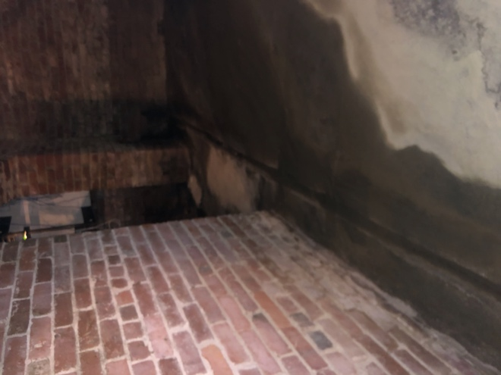
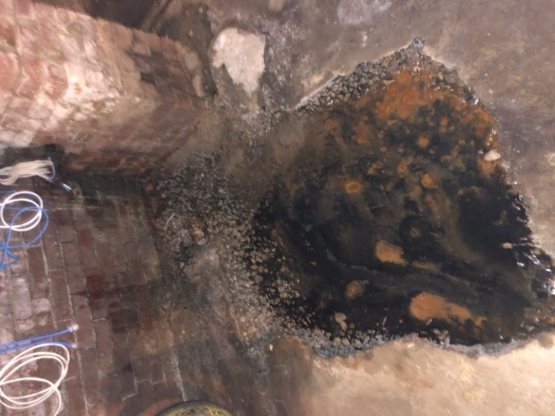
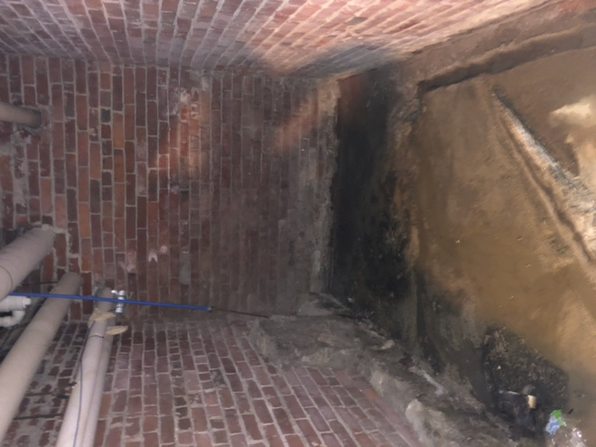
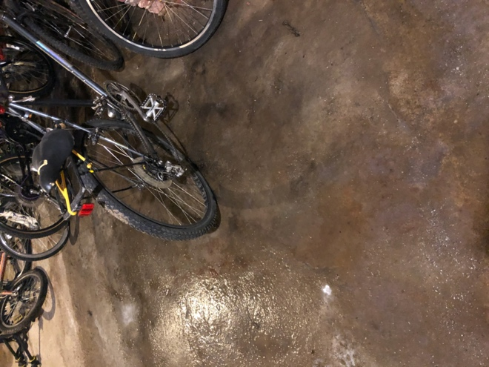
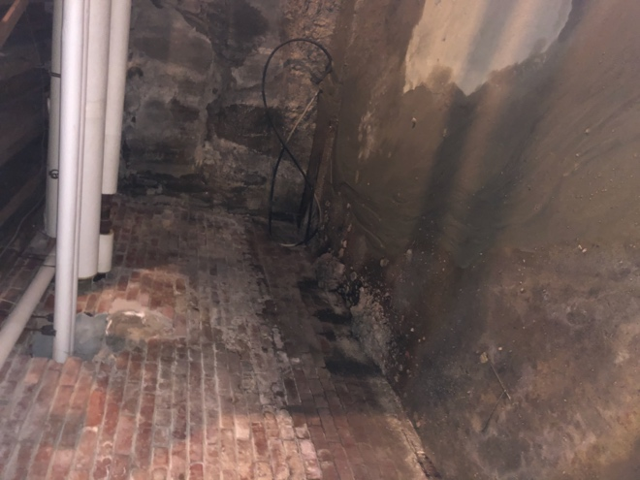
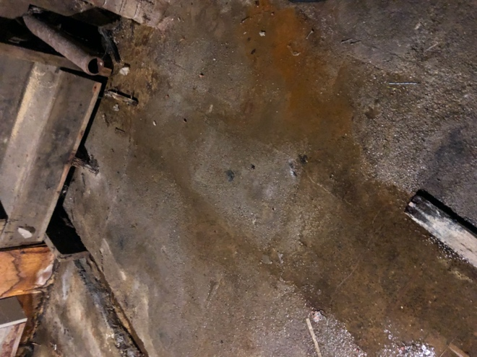
Opera House / Town Office: Potential FIMs
Lighting:
Retrofit or replace all interior lighting to LED
Building Envelope:
Solve the water issues in the basement with a sealed crawl space liner or EPDM membrane on the floor and walls
Additional Improvements:
Roof replacement to eliminate the current leaking issues
Installing a new roof hatch
O2 Prime installation
New Wi-Fi programmable Thermostats
Phase 2 options:
Insulate attic once the water in the basement is under control and not providing moisture to rise

Slide 5
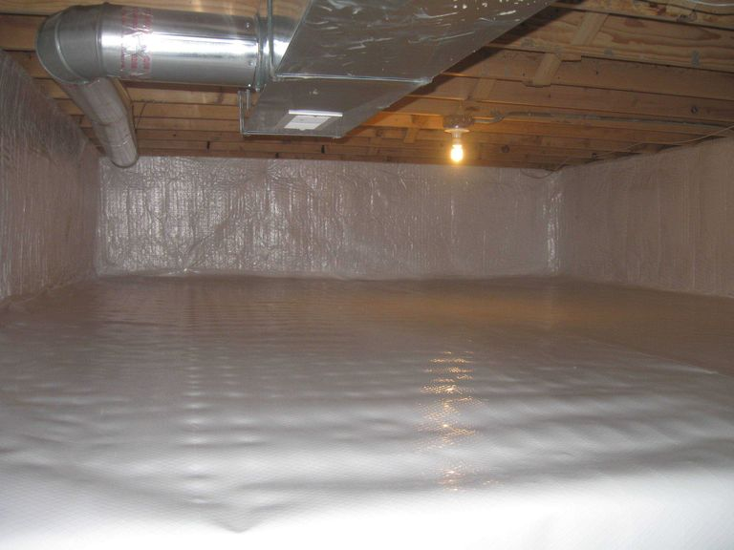
Example – Crawl space liner

Slide 6
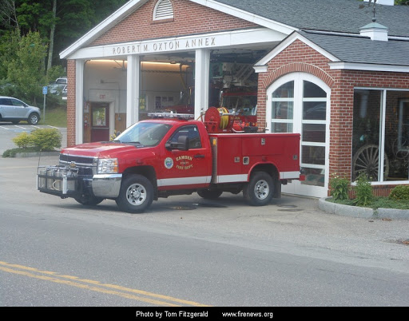
Public Safety Buildings: Potential FIMs
Lighting:
Retrofit or replace all interior lighting to LED
Additional Improvement:
Installing heat pump in fitness room
Replacing 7 heating/cooling heat pump units and AHU’s
Installing mini split system for the antique pumper showcase
Phase 2 options:
Roof replacement for both buildings
Rooftop Solar option once roof is replaced

Slide 7
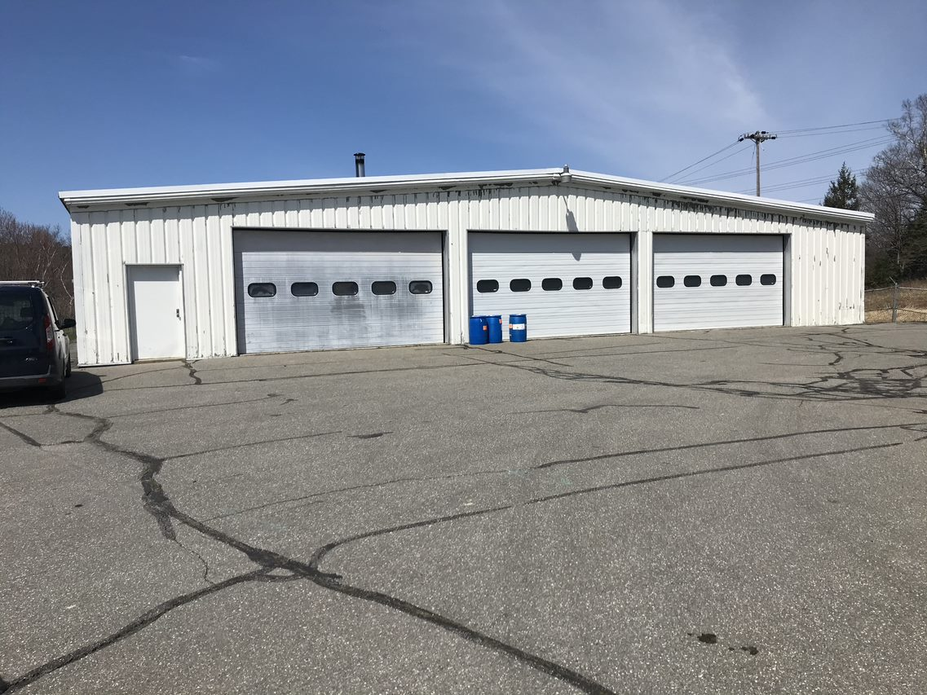
Public Works and WWTP: Potential FIMs
Lighting: WWTP and Public Works
Retrofit or replace all interior lighting to LED
Building Envelope: Public Works
Weather stripping on external building doors and garage doors
Additional Improvements: Public Works
Heat Pump for office space
Phase 2 options:
Potential rooftop solar at WWTP

Slide 8
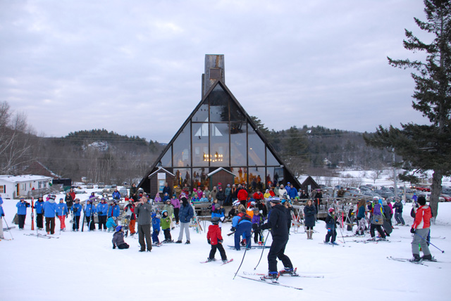
Snow Bowl: Potential FIM’s
Lighting:
Retrofit or replace all interior lighting to LED
Replace existing trial lighting fixtures
Install new parking lot lighting/LED
Building Envelope:
Weather stripping on external building doors
Replace single pane windows with double pane windows
Improve the front entrance and appearance
Additional Improvements:
Geothermal Heating and cooling System to make the move
clean energy and reduce the Town’s carbon footprint

Slide 9
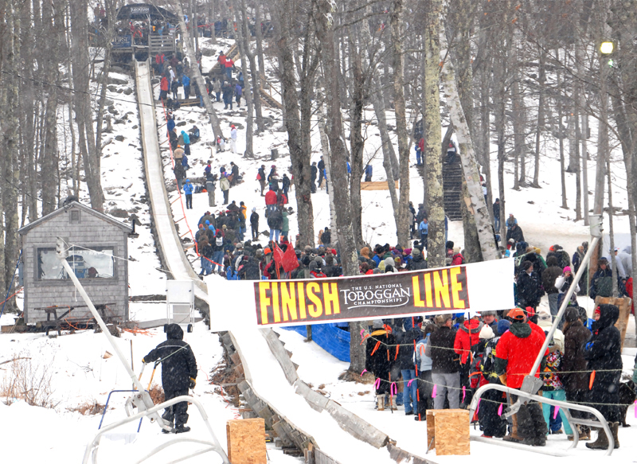
Snow Bowl: Potential Phase 2 options
Improve the snow making process to reduce energy usage,
improve reliability, flexibility and sustainability.
Roof Replacement and Insulation

Slide 10
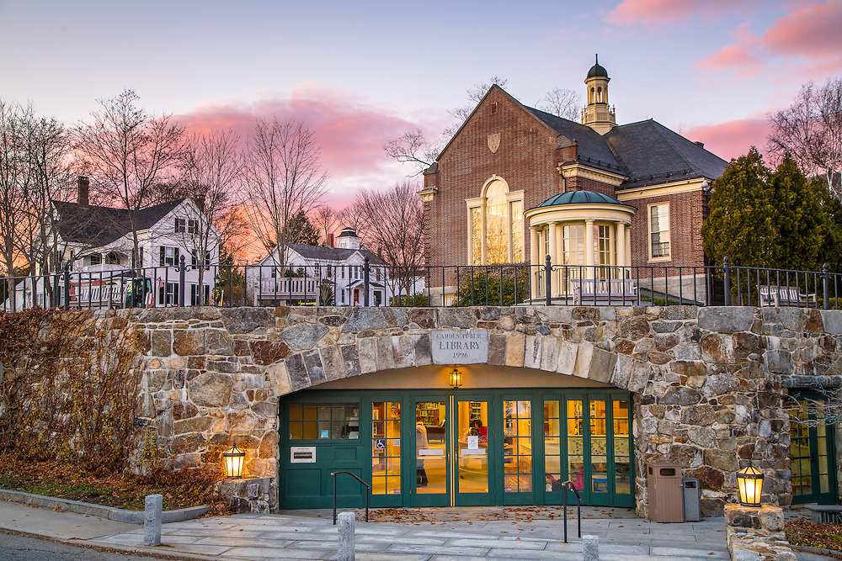
Camden Library: Potential FIMs
Lighting and controls:
Retrofit or replace all interior lighting to LED
Install programmable controls and wireless dimmers
Building Envelope:
Weather stripping on external building doors
Insulate attic and walls that need to improved
Additional Improvements:
Install new propane boiler to replace current oil burner
Install new building automation system and implementing
energy saving control strategies
Install O2 prime

Slide 11
Potential Projects for the Town of Camden:
Annual Contribution
Town = $79,000
Library = $26,000
OPTION 1 PROJECT
Annual Contribution
Town = $60,000
Library = $26,000
OPTION 2 PROJECT
Annual Contribution
Town = $46,000
Library = $26,000
OPTION 3 PROJECT
Energy & Operational Savings
$47,000 (22%)
Energy & Operational Savings
$47,000 (22%)
Energy & Operational Savings
$45,000 (20%)
Option 1 Total Project Cost
$2,308,000
Lighting Retrofit @ All Buildings
Lighting Controls @ Library
New Parking Lot Lights @ Snow Bowl
New Heat Pumps @ Public Safety & Public Works
Basement Membrane @ Opera House
Building Weatherization @ All Buildings
New Windows @ Snow Bowl
Attic Insulation @ Library
New Building Automation System @ Library
Boiler Replacement and Fuel Conversion @ Library
O2 Prime @ Library & Town Office
Geothermal Heating and Cooling System @ Snow Bowl
Roof Replacement @ Opera House
Option 2 Total Project Cost
$2,040,000
Lighting Retrofit @ All Buildings
Lighting Controls @ Library
New Parking Lot Lights @ Snow Bowl
New Heat Pumps @ Public Safety & Public Works
Basement Membrane @ Opera House
Building Weatherization @ All Buildings
New Windows @ Snow Bowl
Attic Insulation @ Library
New Building Automation System @ Library
Boiler Replacement and Fuel Conversion @ Library
O2 Prime @ Library & Town Office
Geothermal Heating and Cooling System @ Snow Bowl
X Roof Replacement @ Opera House
Option 3 Total Project Cost
$1,810,000
Lighting Retrofit @ All Buildings
Lighting Controls @ Library
New Parking Lot Lights @ Snow Bowl
New Heat Pumps @ Public Safety & Public Works
Basement Membrane @ Opera House
Building Weatherization @ All Buildings
New Windows @ Snow Bowl
Attic Insulation @ Library
New Building Automation System @ Library
Boiler Replacement and Fuel Conversion @ Library
O2 Prime @ Library & Town Office
X Geothermal Heating and Cooling
System @ Snow Bowl
Boiler Replacement @ Snow Bowl
Roof Replacement @ Opera House

Slide 12
Carbon Reduction and Cost Savings Summary by Location

Slide 13

Next Steps
WE ARE HERE
RFP
Letter of Intent
(LOI)
Contract
Change of Usage, Consumption, Accounting.
Preliminary Analysis
Detailed
Analysis
Implementation
Guarantee Phase
Conceptional
Presentation
Feasibility Study Presentation
Preliminary
Audit
RFP
Response
Investment Grade Audit (IGA)
Planning, Installation, Project Management
Investment Grade Audit (IGA)

Slide 14
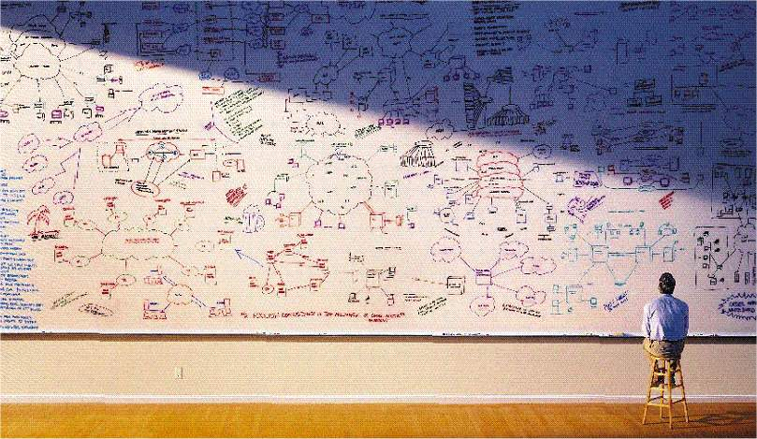

Elmer Arbogast
Energy Engineer ME & NH
Energy Performance Services
Smart Infrastructure
207-205-5954 mobile
Elmer.Arbogast@siemens.com
Denny Webber
Market Manager ME & NH
Energy Performance Services
Smart Infrastructure
207-205-9149 mobile
Denny.Webber@siemens.com
Colleen Fissette
Energy Engineer ME & NH
Energy Performance Services
Smart Infrastructure
781-738-7147 mobile
Colleen.Fissette@siemens.com

